Slide 1
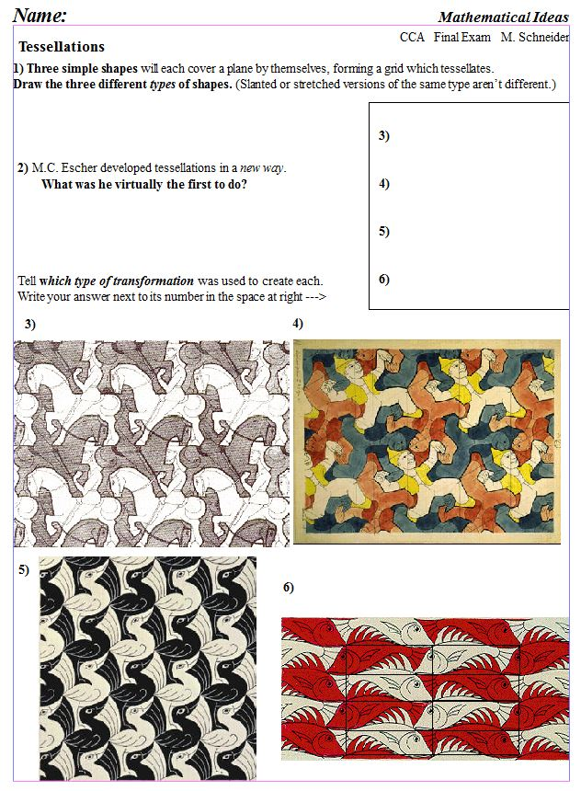
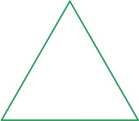
www.constructingtheuniverse.com
1 each
Glide-Reflection
Rotation
3
each
1
He made tessellations using recognizable objects (not just geometry).
5)
Glide
6)
Glide-Reflection

Slide 2
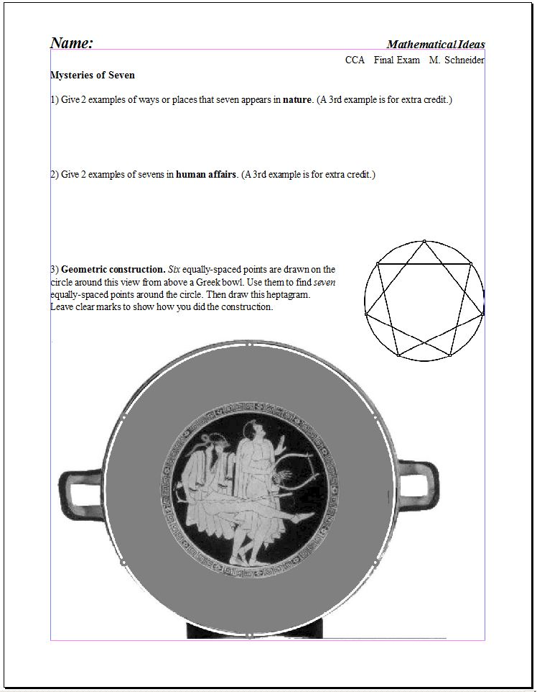
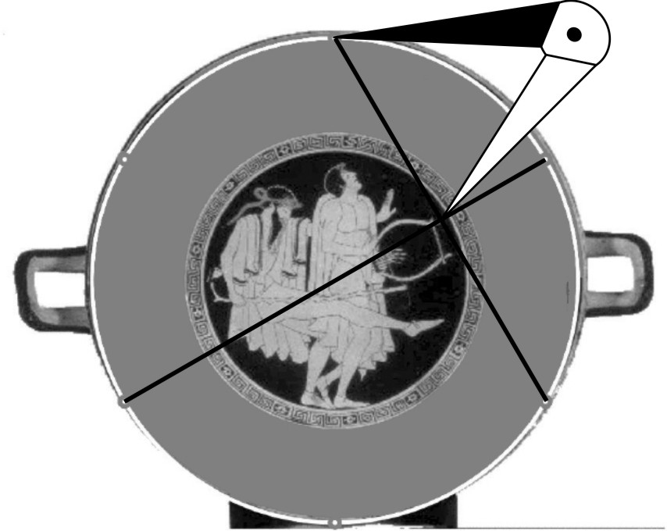
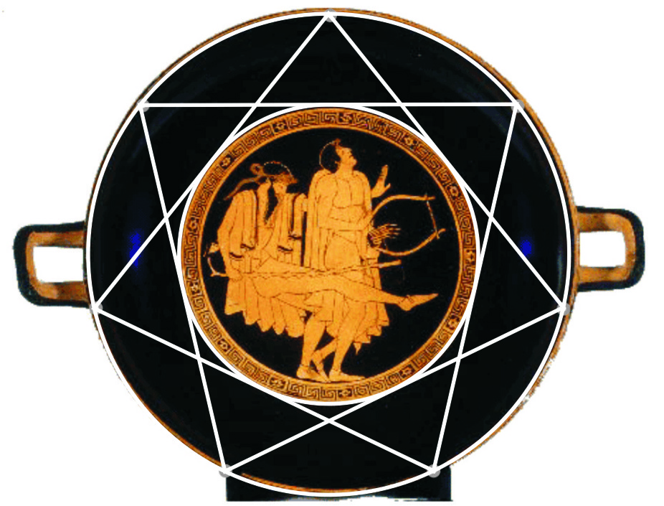
2
each
+2
7 colors of visible light (rainbow); 7 crystal systems;
7 openings in head; 7 petaled flowers, …
+2
2
each
7 days of the week; 7 celestial bodies visible to human eye; 7 sins/virtues; 7 shuffles randomize cards; 7 sum of opposite sides of dice; give examples from mythology, religion, fairy tales; …
14

Slide 3
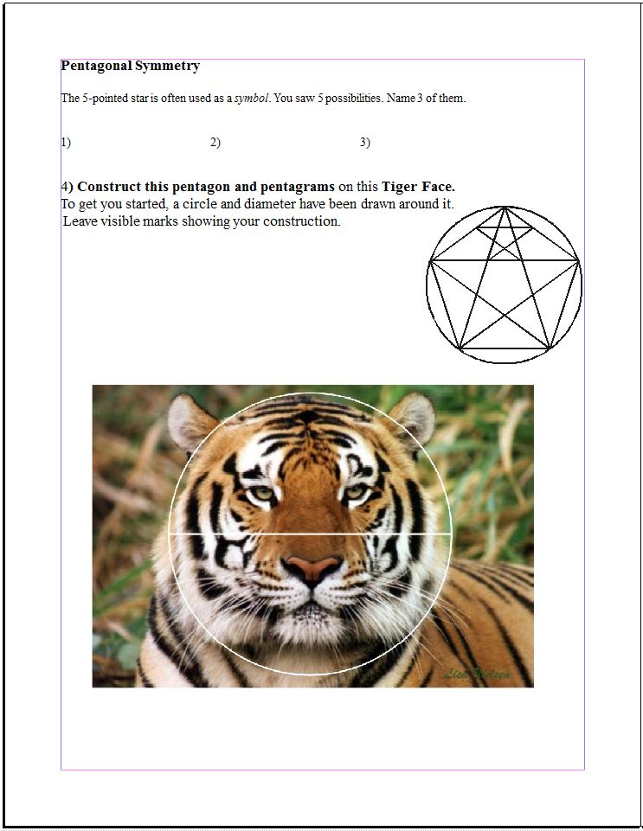
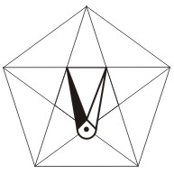
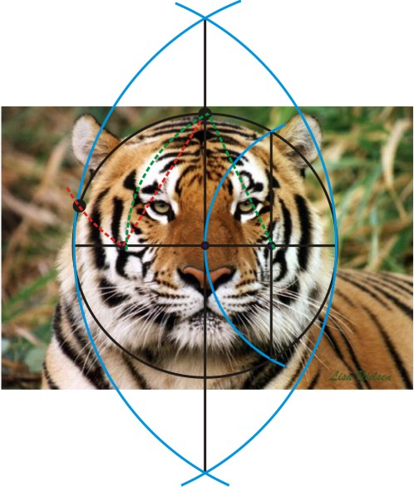
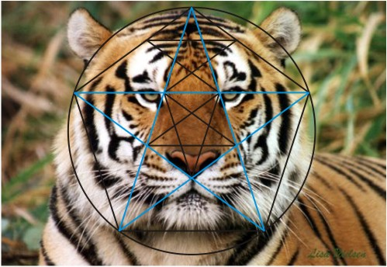
1
each
Life, Regeneration, Humanness, Excellence, Righteous Authority
12
4 points for Almond
4 for pentagon construction
4 for Accuracy

Slide 4
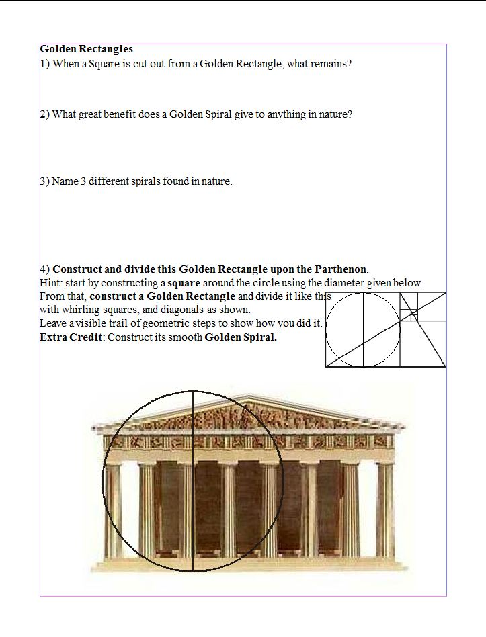
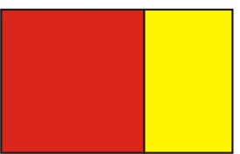
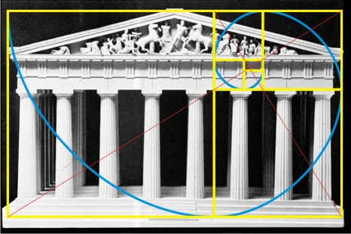
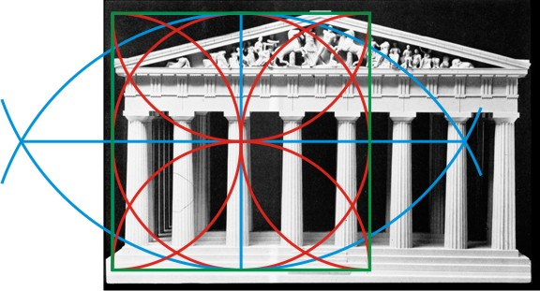
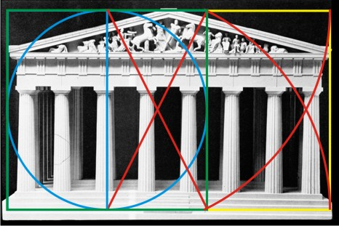
4
A small Golden Rectangle
3
Balance during growth
2
each
Many answers possible – shells, horns, tails, fist, water whirlpool, galaxy, etc
4 for Almond, 5 to construct square, 2 construct GR, 4 whirling squares, +2 spiral extra credit
15

Slide 5
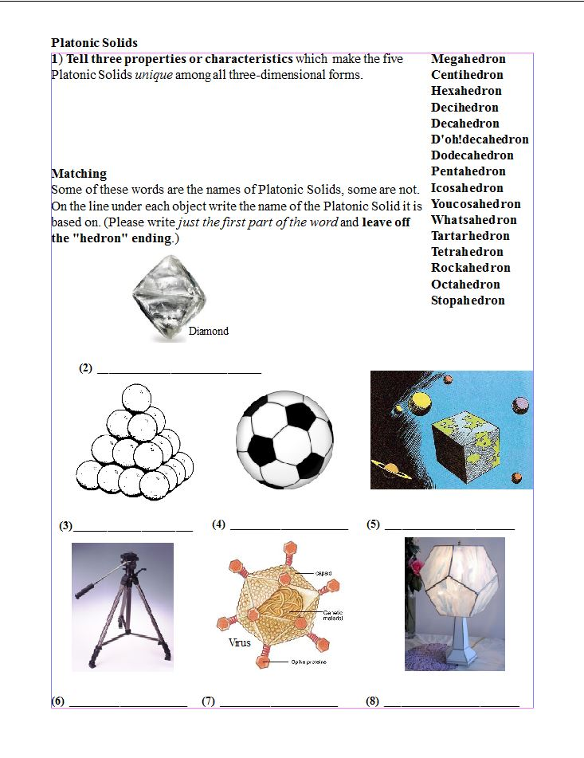
1
each
Equal angles, equal edge lengths, same faces, equal distance from corners to center
1
2 each
Octa
Tetra
Dodeca
Hexa
Tetra
Icosa
Dodeca

Slide 6
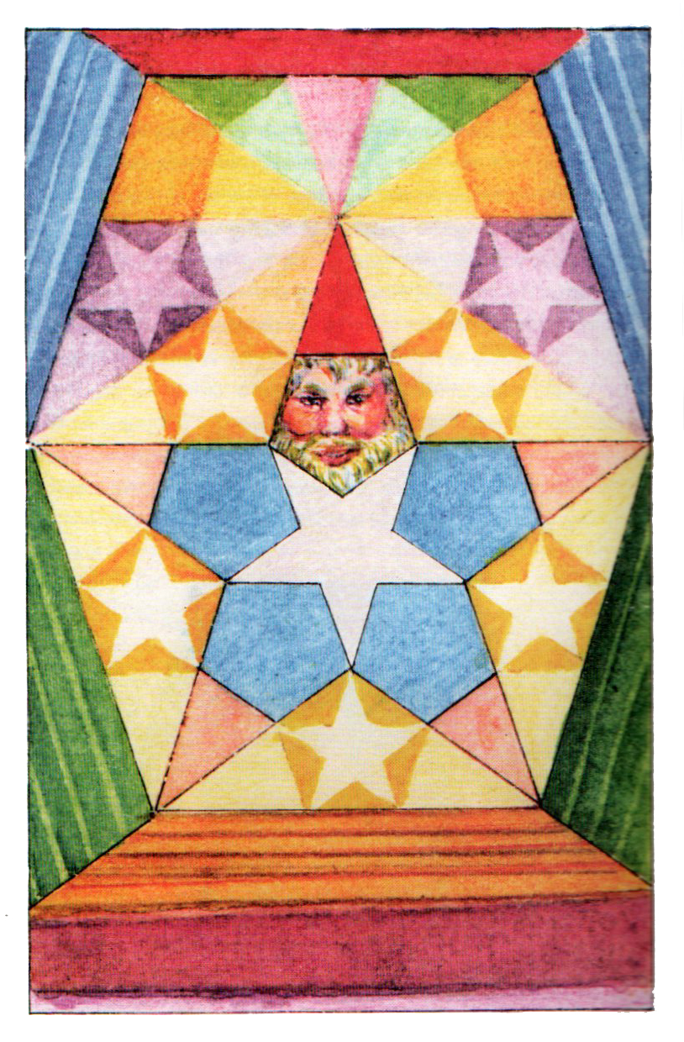
Goodbye and Good Luck!

Slide 8
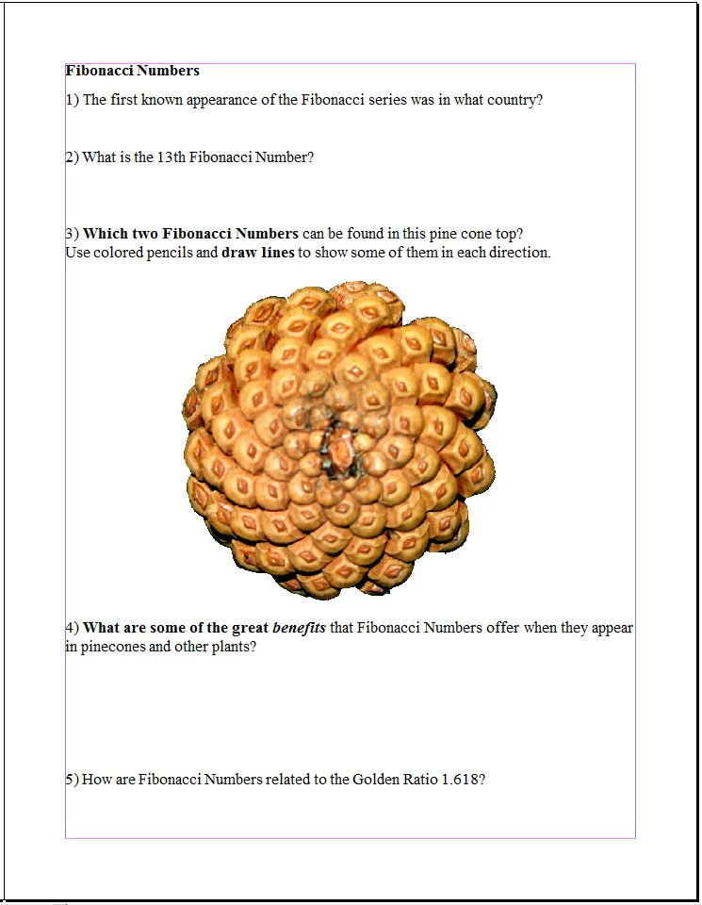
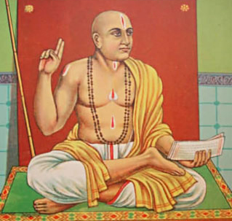
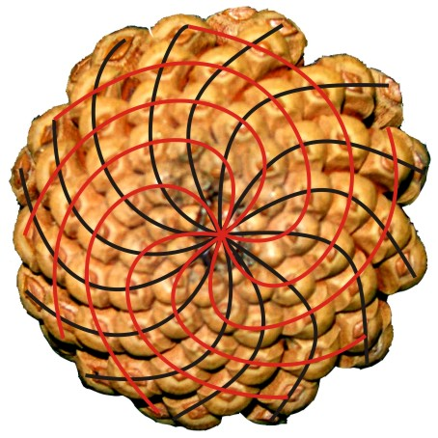
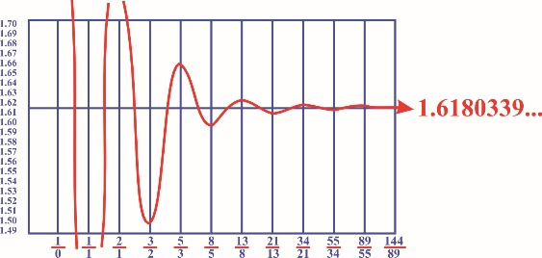
2
India
10th
3
0, 1, 1, 2, 3, 5, 8, 13, 21, 34
8 & 13
6
(3 each)
3
Balanced growth, best fit, maximum exposure to sun, rain & pollen, least overlap, harmonious expansion, etc.
3
Fractions made by consecutive Fibonacci Numbers get closer and closer to 1.618…

Slide 9
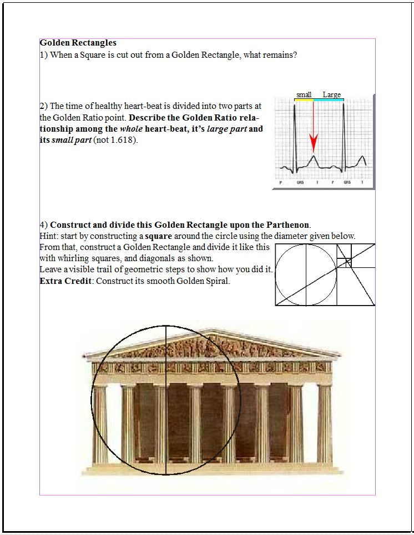
4
A small Golden Rectangle
4
Whole
Large part
Large part
Small part
=
2 each
2 for Almond, 3 to construct square, 3 construct GR, 2 whirling squares, +2 spiral extra credit
10

